Slide 1
Computer Vision project SLAM/SFM
Ido Ben Shachar
Ehud Gordon

Slide 2
Our project
Implementing visual SLAM/SFM
Such as
ORB-SLAM
Build Rome in a day

Slide 3
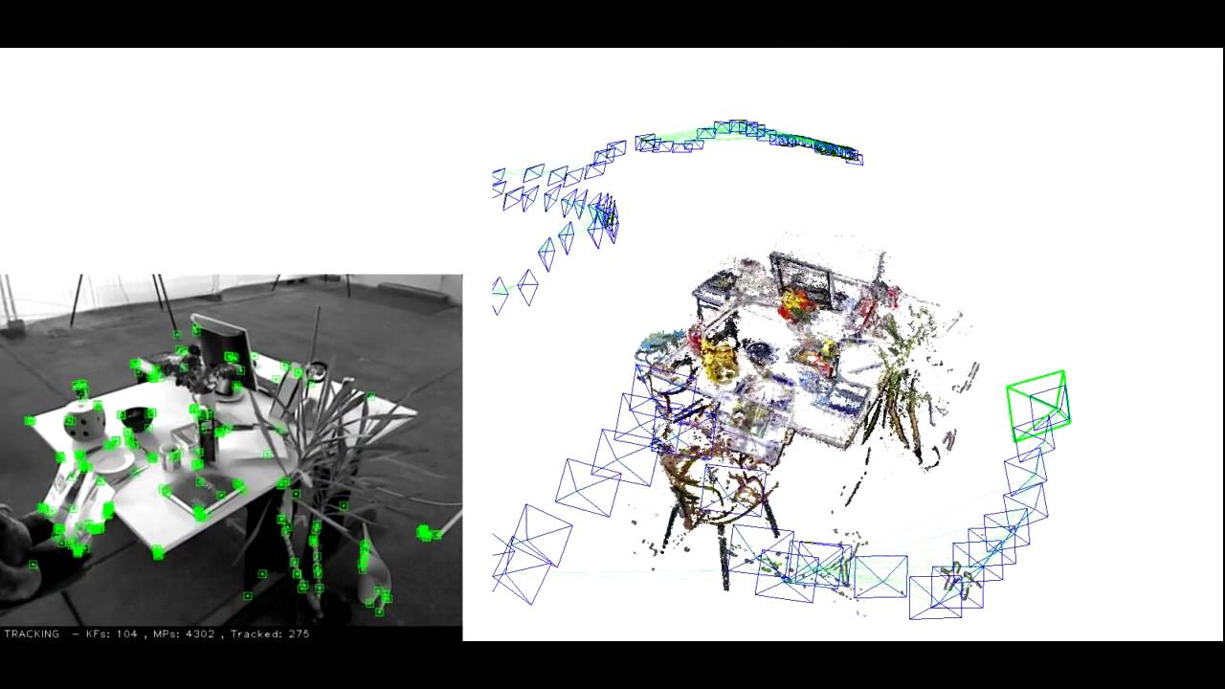
ORB-SLAM

Slide 4
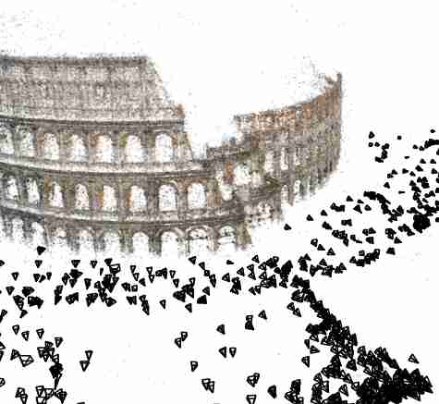
Build Rome in a day

Slide 5
Flow
A. Preliminary step- Calibration
Capture Video
Extract Frames
Undistort Frames
Extract SIFT Points from Key Frames
Match Consecutive Key Frames
Get Inlier Point Matches + Essential
Get RT
Trialgulate Points
Follow points & calculate Average 3D Coordinates
Display Points & Camera Locations

Slide 6
Flow
A. Preliminary step- Calibration
Capture Video
Extract Frames
Undistort Frames
Extract SIFT Points from Key Frames
Match Consecutive Key Frames
Get Inlier Point Matches + Essential
Get RT
Trialgulate Points
Follow points & calculate Average 3D Coordinates
Display Points & Camera Locations

Slide 7
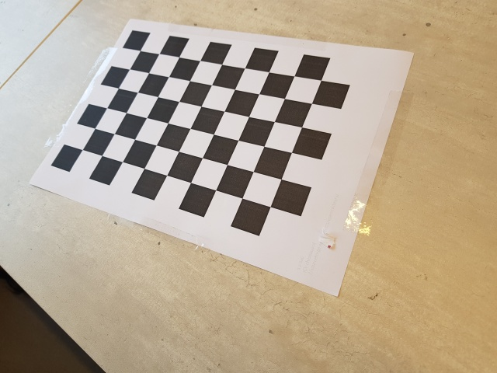
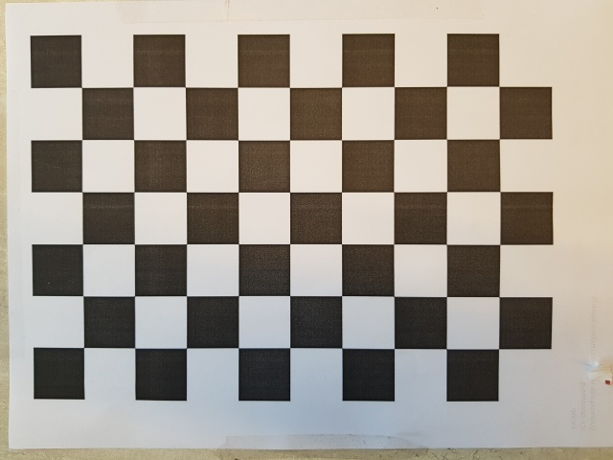
Calibration
We get intrinsic matrix K and distortion params

Slide 8
Flow
A. Preliminary step- Calibration
Capture Video
Extract Frames
Undistort Frames
Extract SIFT Points from Key Frames
Match Consecutive Key Frames
Get Inlier Point Matches + Essential
Get RT
Trialgulate Points
Follow Points & Calculate Average 3D Coordinates
Display Points & Camera Locations

Slide 9
Flow
A. Preliminary step- Calibration
Capture Video
Extract Frames
Undistort Frames
Extract SIFT Points from Key Frames
Match Consecutive Key Frames
Get Inlier Point Matches + Essential
Get RT
Trialgulate Points
Follow Points & Calculate Average 3D Coordinates
Display Points & Camera Locations

Slide 10
Flow
A. Preliminary step- Calibration
Capture Video
Extract Frames
Undistort Frames
Extract SIFT Points from Key Frames
Match Consecutive Key Frames
Get Inlier Point Matches + Essential
Get RT
Trialgulate Points
Follow Points & Calculate Average 3D Coordinates
Display Points & Camera Locations

Slide 11
Flow
A. Preliminary step- Calibration
Capture Video
Extract Frames
Undistort Frames
Extract SIFT Points from Key Frames
Match Consecutive Key Frames
Get Inlier Point Matches + Essential
Get RT
Trialgulate Points
Follow Points & Calculate Average 3D Coordinates
Display Points & Camera Locations

Slide 12
Flow
A. Preliminary step- Calibration
Capture Video
Extract Frames
Undistort Frames
Extract SIFT Points from Key Frames
Match Consecutive Key Frames
Get Inlier Point Matches + Essential
Get RT
Trialgulate Points
Follow Points & Calculate Average 3D Coordinates
Display Points & Camera Locations

Slide 13

Finding initial matches
For every $P_{1}$ in ${image}_{1}$ find $P_{2}$ and ${P′}_{2}$ of ${image}_{2}$ with closest descriptor
If ${|desc}_{P_{1}}−{desc}_{P_{2}}|$ < $0.5 ⋅{|desc}_{P_{1}}−{desc}_{{P′}_{2}}|$
Keep match

Slide 14

RANSAC
Finding Essential $E$ and Inlier matches such that for every match of $p_{1}$ in ${image}_{1}$ and $p_{2}$ of ${image}_{2}$ it holds that
$p_{2}^{T}⋅E⋅p_{1}≈0$

Slide 15
Get Pose
Use points to find which of 4 possible RTs can be extracted from Essential matrix

Slide 16
Triangulate Points
Use extracted RT and point observations to triangulate and find 3D coordinates of points

Slide 17
Flow
A. Preliminary step- Calibration
Capture Video
Extract Frames
Undistort Frames
Extract SIFT Points from Key Frames
Match Consecutive Key Frames
Get Inlier Point Matches + Essential
Get RT
Trialgulate Points
Follow Points & Calculate Average 3D Coordinates
Display Points & Camera Locations

Slide 18
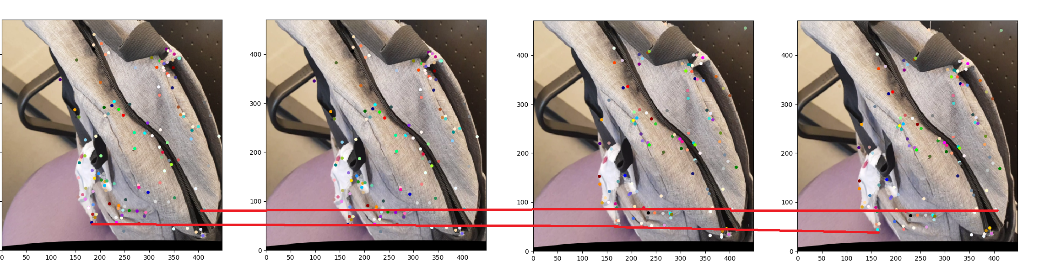
Follow Points
Use average 3D location of point
Color of point is the color where it was first observed

Slide 19
Flow
A. Preliminary step- Calibration
Capture Video
Extract Frames
Undistort Frames
Extract SIFT Points from Key Frames
Match Consecutive Key Frames
Get Inlier Point Matches + Essential
Get RT
Trialgulate Points
Follow points & calculate Average 3D Coordinates
Display Points & Camera Locations

Slide 20

Display
We get $RT_{2→1}$, $RT_{3→2}$, $RT_{4→3}$… $RT_{n→n−1}$
We accumulate RTs
$RT_{i→1}=RT_{2→1}⋅RT_{3→2}⋅⋅⋅RT_{i→i−1}$
We bring all point coordinates to Frame1 coordinate system

Slide 21
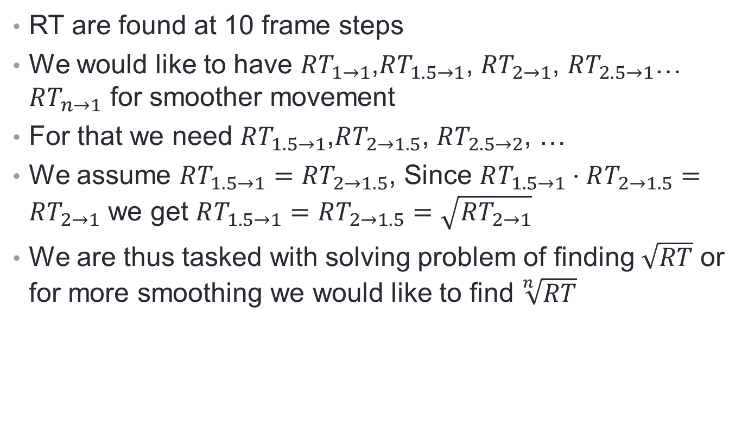
Smoothing RT
RT are found at 10 frame steps
We would like to have $RT_{1→1}$,$RT_{1.5→1}$, $RT_{2→1}$, $RT_{2.5→1}$… $RT_{n→1}$ for smoother movement
For that we need $RT_{1.5→1}$,$RT_{2→1.5}$, $RT_{2.5→2}$, …
We assume $RT_{1.5→1}=RT_{2→1.5}$, Since $RT_{1.5→1}⋅RT_{2→1.5}=RT_{2→1}$ we get $RT_{1.5→1}=RT_{2→1.5}=\sqrt{RT_{2→1}}$
We are thus tasked with solving problem of finding $\sqrt{RT}$ or for more smoothing we would like to find $\sqrt[n]{RT}$

Slide 22
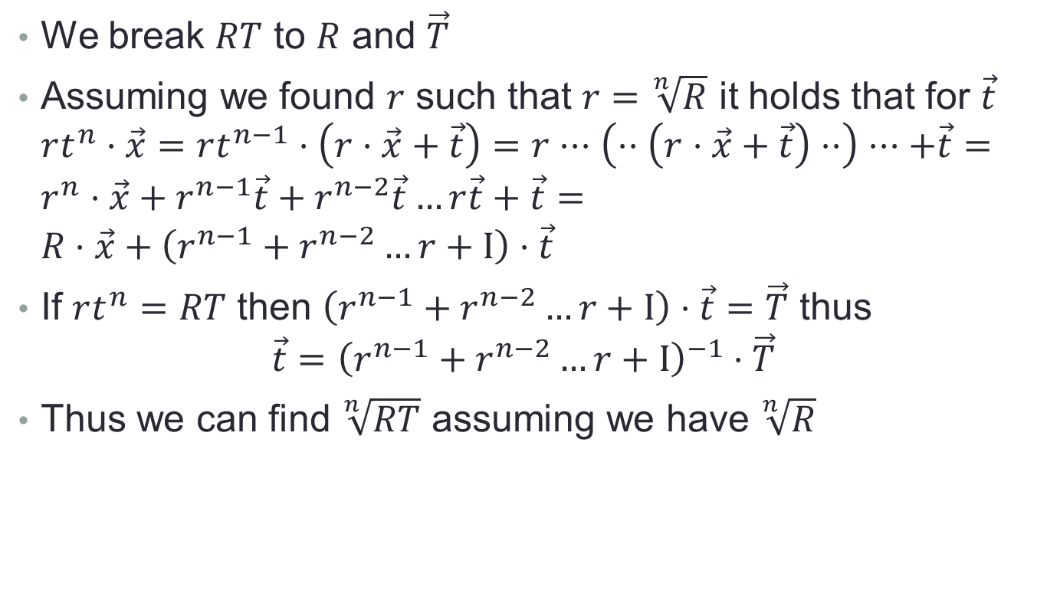

Finding $\sqrt[n]{RT}$
We break $RT$ to $R$ and $\vec{T}$
Assuming we found $r$ such that $r=$ $\sqrt[n]{R}$ it holds that for $\vec{t}$ $rt^{n}⋅\vec{x}=rt^{n−1}⋅\left(r⋅\vec{x}+\vec{t}\right)=r⋅⋅⋅\left(⋅⋅\left(r⋅\vec{x}+\vec{t}\right)⋅⋅\right)⋅⋅⋅+\vec{t}=r^{n}⋅\vec{x}+r^{n−1}\vec{t}+r^{n−2}\vec{t}…r\vec{t}+\vec{t}=R⋅\vec{x}+\left(r^{n−1}+r^{n−2}…r+I\right)⋅\vec{t}$
If $rt^{n}=RT$ then $\left(r^{n−1}+r^{n−2}…r+I\right)⋅\vec{t}=\vec{T}$ thus
$$\vec{t}={\left(r^{n−1}+r^{n−2}…r+I\right)}^{−1}⋅\vec{T}$$
Thus we can find $\sqrt[n]{RT}$ assuming we have $\sqrt[n]{R}$

Slide 23
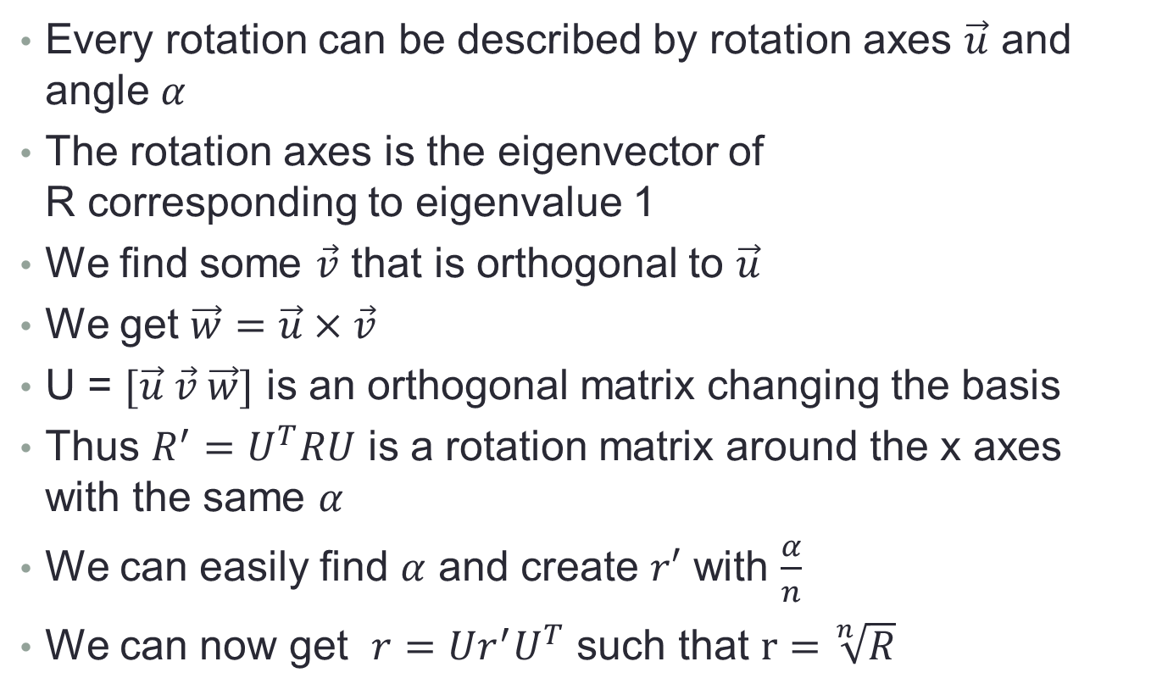

Finding $\sqrt[n]{R}$
Every rotation can be described by rotation axes $\vec{u}$ and angle $α$
The rotation axes is the eigenvector of R corresponding to eigenvalue 1
We find some $\vec{v}$ that is orthogonal to $\vec{u}$
We get $\vec{w}=\vec{u}×\vec{v}$
U = $[\vec{u} \vec{v} \vec{w}]$ is an orthogonal matrix changing the basis
Thus $R^{′}=U^{T}RU$ is a rotation matrix around the x axes with the same $α$
We can easily find $α$ and create $r′$ with $\frac{α}{n}$
We can now get $r=Ur^{′}U^{T}$ such that $r=\sqrt[n]{R}$

Slide 24
Possible Improvements
Bundle Adjust- was implemented but is still buggy
Smart choises for key frames
Match not only consecutive key frames to remove noise from RTs
Find correct scale for translations- was implemented but not used yet
Filter points differently
Turn point cloud to mesh
Many more…

Slide 25
Now enjoy the demonstration

